Slide 1

POSTS REPORT
Instagram Posts Report
PERIOD
COMPARISON PERIOD
CHANNEL
02 Jul 2026 - 31 Jul 2026
Instagram

Slide 2
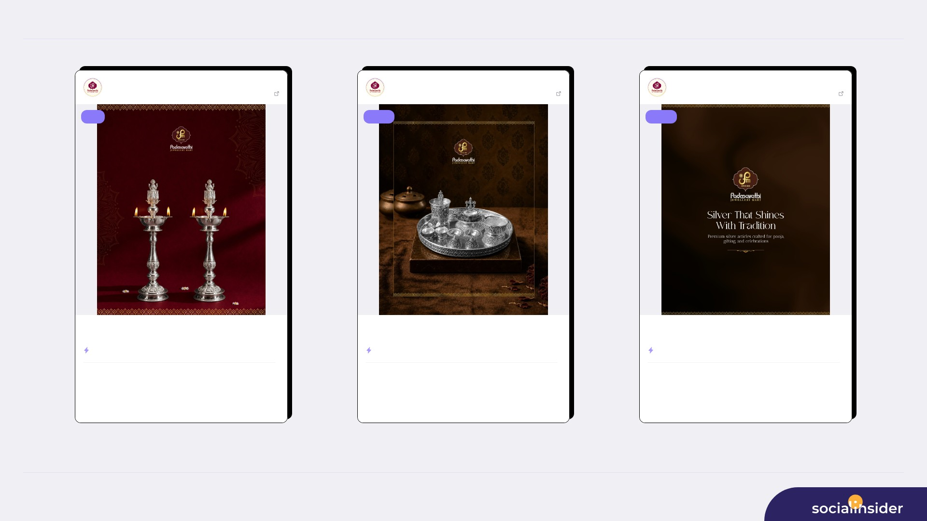
TOP CONTENT
2/8
Padmavathi Jewe...
Jul 20, 2026
Padmavathi Jewe...
Jul 13, 2026
Padmavathi Jewe...
Jul 02, 2026
563 followers
View post
563 followers
View post
563 followers
View post
reel
image
image
Light up your sacred moments with the elegance of silver. ✨ Discover ...
Add a touch of tradition and elegance to every ritual. ✨ Padmavathi J...
Silver that shines with tradition. ✨🤍 Explore premium silver article...
ENGAGEMENT RATE
2.31%
ENGAGEMENT RATE
1.07%
ENGAGEMENT RATE
0.89%
246
13
605
6
504
5
VIEWS
LIKES
VIEWS
LIKES
VIEWS
LIKES
0
153
0
550
0
458
COMMENTS
REACH
COMMENTS
REACH
COMMENTS
REACH
Source: Socialinsider
Date range: 02 Jul 2026 - 31 Jul 2026

Slide 3
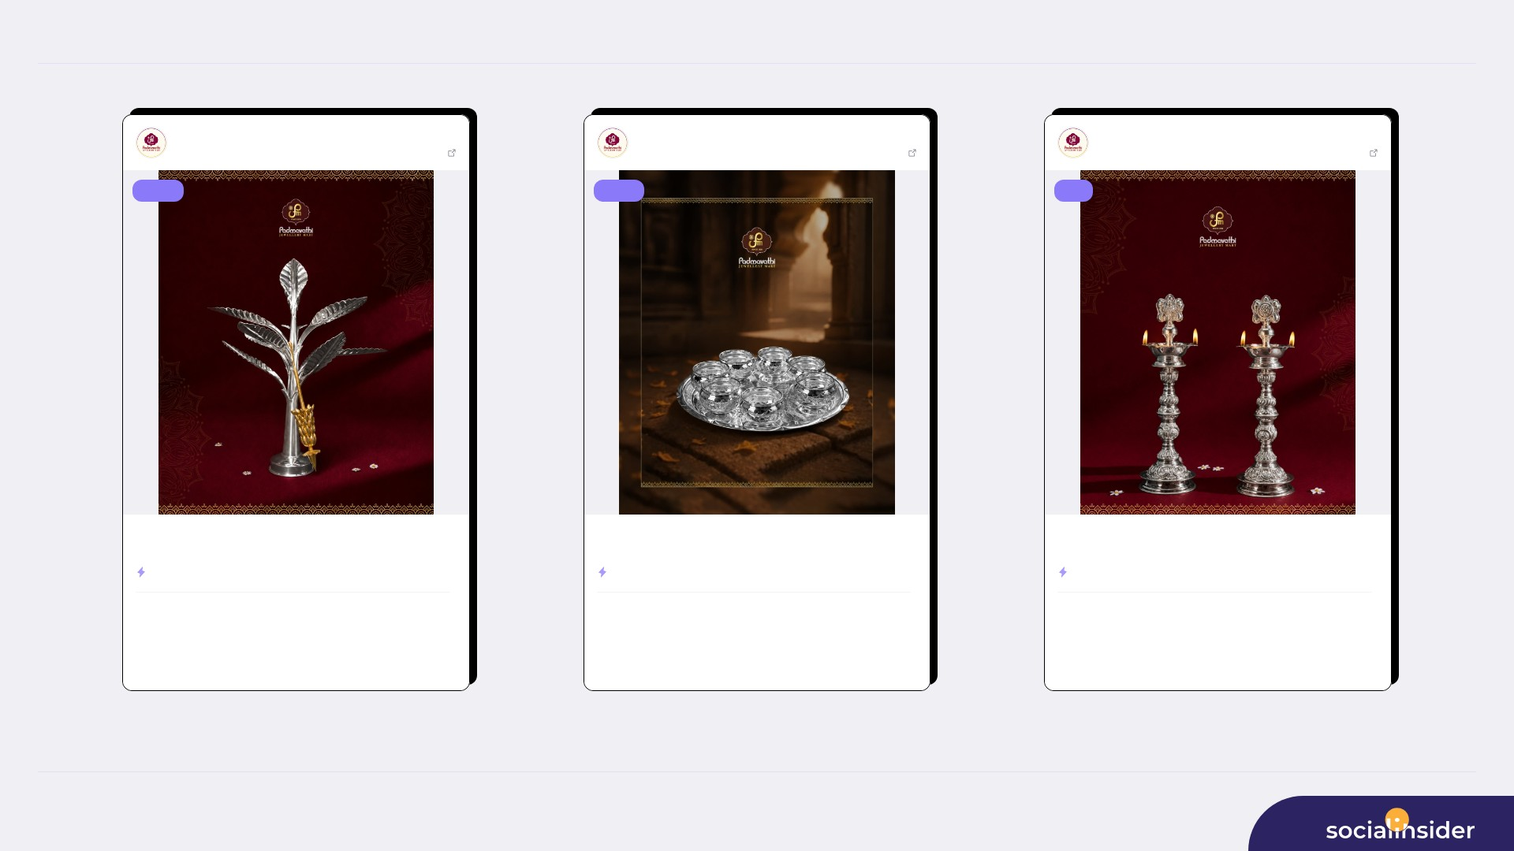
TOP CONTENT
3/8
Padmavathi Jewe...
Jul 27, 2026
Padmavathi Jewe...
Jul 02, 2026
Padmavathi Jewe...
Jul 20, 2026
563 followers
View post
563 followers
View post
563 followers
View post
image
image
reel
A timeless symbol of prosperity, tradition, and divine grace. ✨ Beaut...
A touch of purity for every divine moment. ✨🙏 Bring home beautifully...
Bring home purity, tradition, and divine elegance. ✨ Explore beautifu...
ENGAGEMENT RATE
0.71%
ENGAGEMENT RATE
0.71%
ENGAGEMENT RATE
0.71%
403
4
403
4
227
4
VIEWS
LIKES
VIEWS
LIKES
VIEWS
LIKES
0
367
0
367
0
141
COMMENTS
REACH
COMMENTS
REACH
COMMENTS
REACH
Source: Socialinsider
Date range: 02 Jul 2026 - 31 Jul 2026

Slide 4
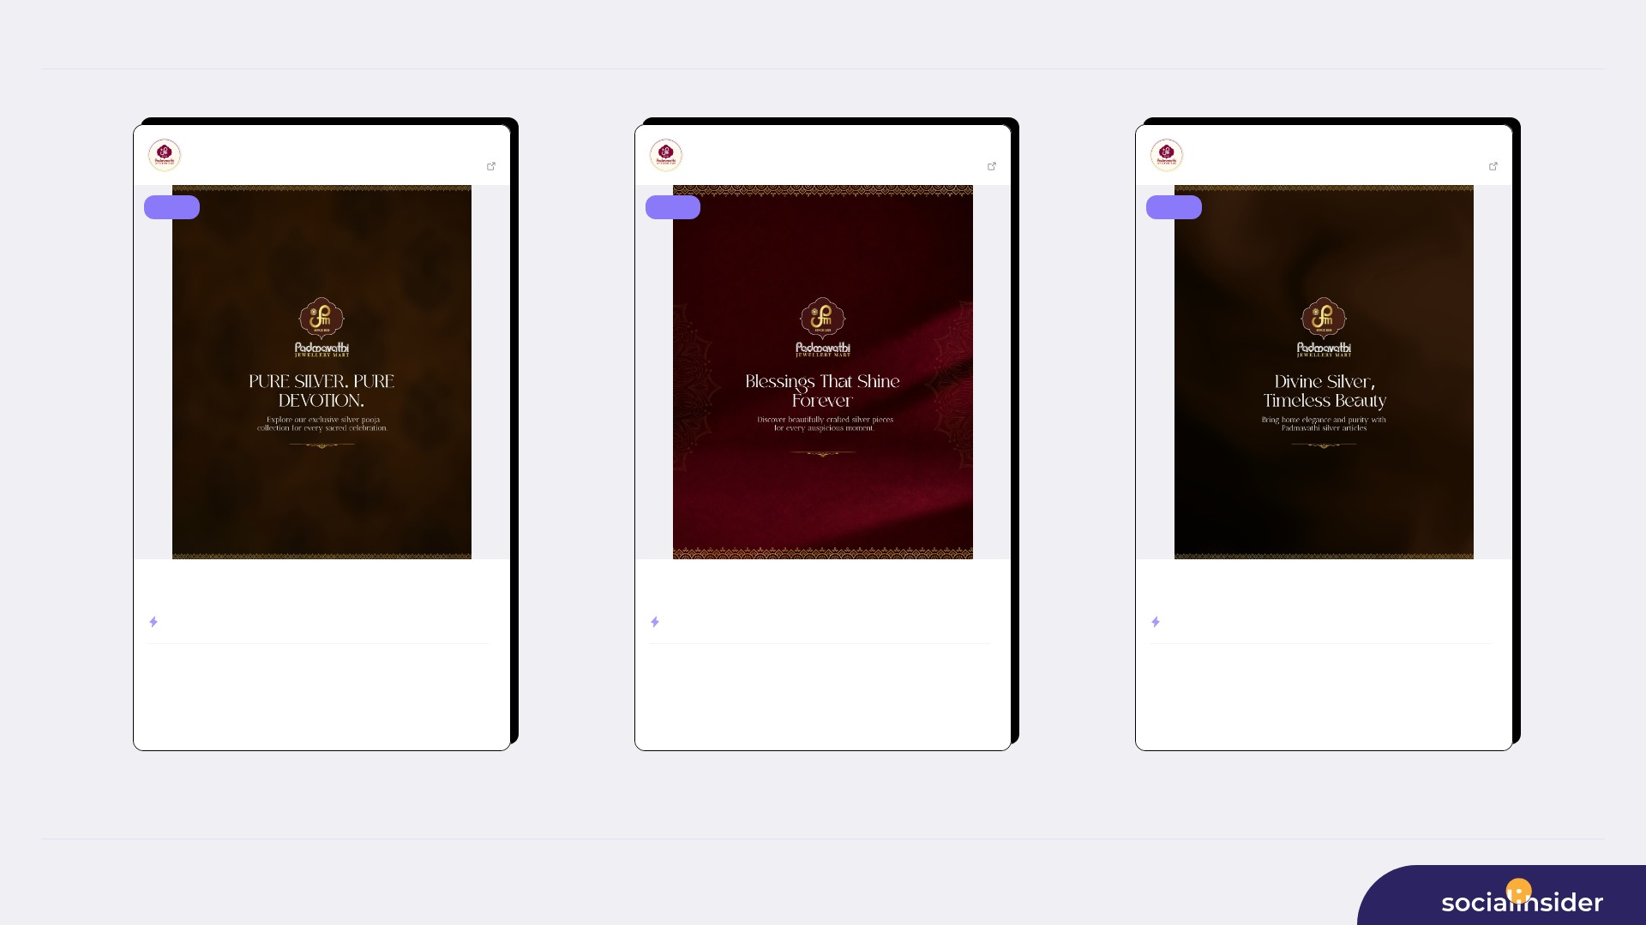
TOP CONTENT
4/8
Padmavathi Jewe...
Jul 13, 2026
Padmavathi Jewe...
Jul 27, 2026
Padmavathi Jewe...
Jul 02, 2026
563 followers
View post
563 followers
View post
563 followers
View post
image
image
image
Pure silver for pure devotion. ✨ Explore Padmavathi Jewellery Mart’s ...
Blessings that shine forever. ✨ Celebrate every auspicious moment wit...
Divine silver, timeless beauty. ✨🤍 Bring home elegance, purity, and ...
ENGAGEMENT RATE
0.53%
ENGAGEMENT RATE
0.53%
ENGAGEMENT RATE
0.53%
302
3
302
3
302
3
VIEWS
LIKES
VIEWS
LIKES
VIEWS
LIKES
0
275
0
275
0
275
COMMENTS
REACH
COMMENTS
REACH
COMMENTS
REACH
Source: Socialinsider
Date range: 02 Jul 2026 - 31 Jul 2026

Slide 5
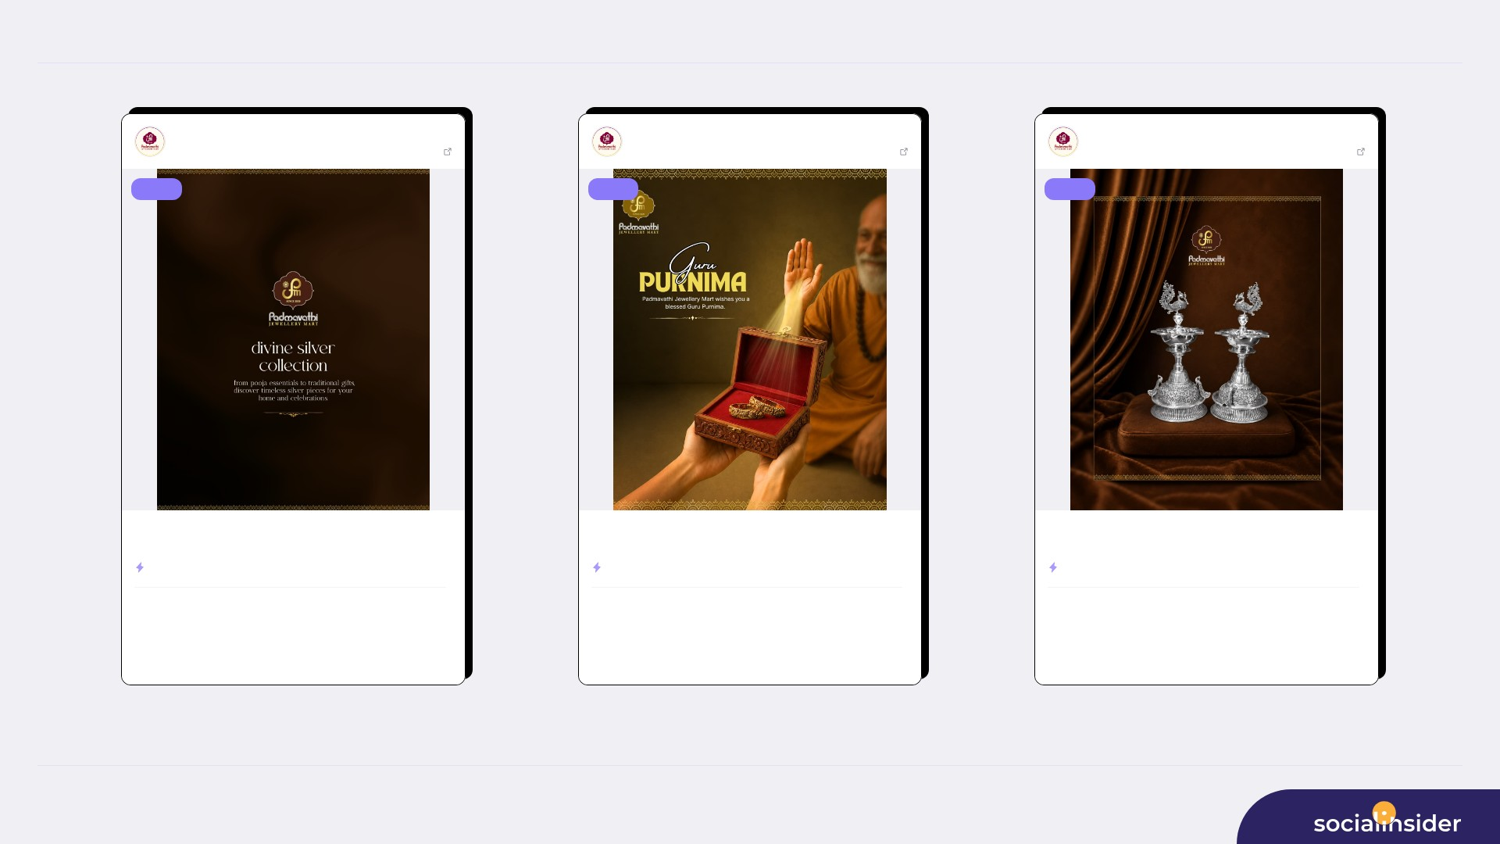
TOP CONTENT
5/8
Padmavathi Jewe...
Jul 06, 2026
Padmavathi Jewe...
Jul 29, 2026
Padmavathi Jewe...
Jul 06, 2026
563 followers
View post
563 followers
View post
563 followers
View post
image
image
image
Discover divine silver pieces crafted for tradition, gifting, and cele...
On this auspicious occasion of Guru Purnima, we express our heartfelt ...
Light up your traditions with divine silver elegance. ✨🙏 Bring home ...
ENGAGEMENT RATE
0.53%
ENGAGEMENT RATE
0.36%
ENGAGEMENT RATE
0.36%
302
3
202
2
202
2
VIEWS
LIKES
VIEWS
LIKES
VIEWS
LIKES
0
275
0
183
0
183
COMMENTS
REACH
COMMENTS
REACH
COMMENTS
REACH
Source: Socialinsider
Date range: 02 Jul 2026 - 31 Jul 2026

Slide 6
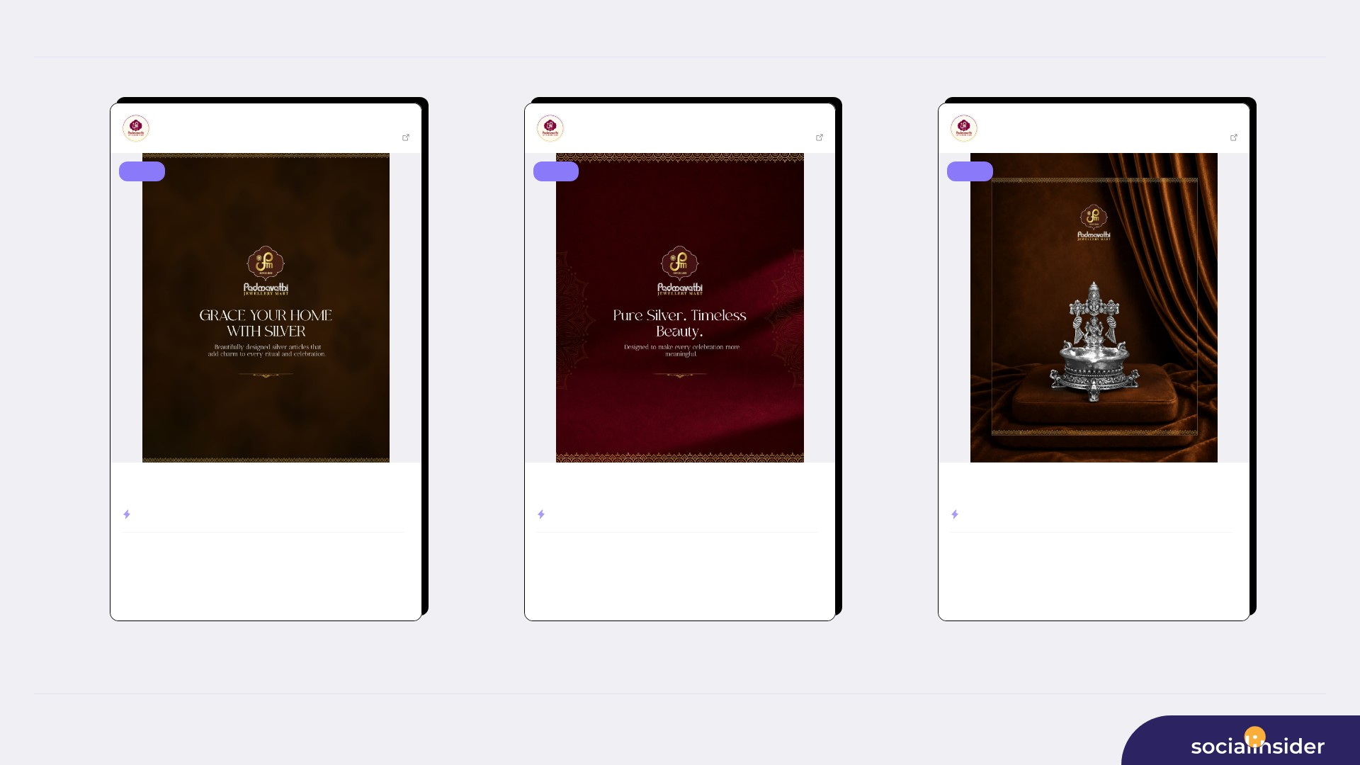
TOP CONTENT
6/8
Padmavathi Jewe...
Jul 13, 2026
Padmavathi Jewe...
Jul 27, 2026
Padmavathi Jewe...
Jul 06, 2026
563 followers
View post
563 followers
View post
563 followers
View post
image
image
image
Bring elegance, tradition, and purity into your home with beautifully ...
Pure silver, crafted to make every celebration more meaningful. ✨ Dis...
Divine elegance crafted in silver. ✨🙏 Bring home purity, tradition, ...
ENGAGEMENT RATE
0.36%
ENGAGEMENT RATE
0.18%
ENGAGEMENT RATE
0.18%
202
2
101
1
101
1
VIEWS
LIKES
VIEWS
LIKES
VIEWS
LIKES
0
183
0
92
0
92
COMMENTS
REACH
COMMENTS
REACH
COMMENTS
REACH
Source: Socialinsider
Date range: 02 Jul 2026 - 31 Jul 2026

Slide 7
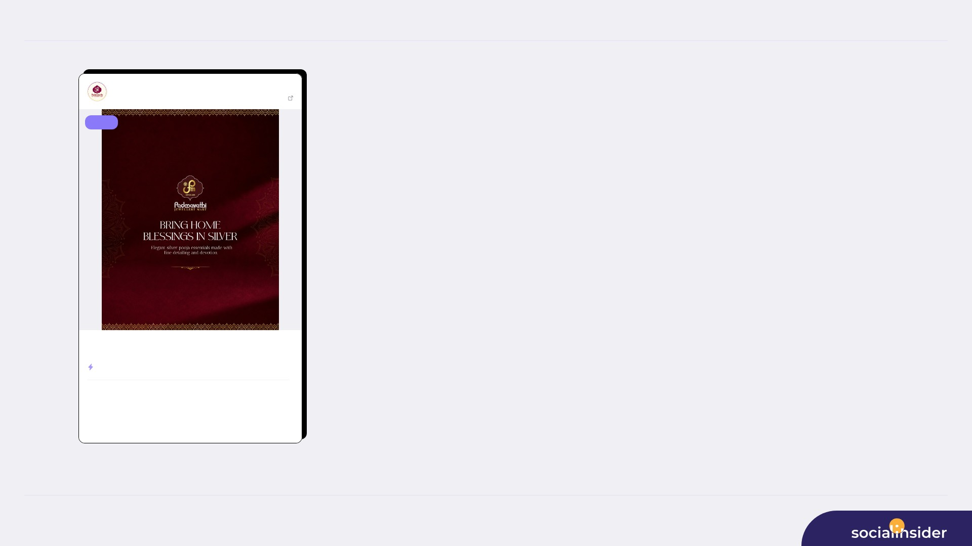
TOP CONTENT
7/8
Padmavathi Jewe...
Jul 20, 2026
563 followers
View post
image
Bring home blessings in silver. ✨ Explore elegant silver pooja essent...
ENGAGEMENT RATE
0.00%
101
0
VIEWS
LIKES
0
92
COMMENTS
REACH
Source: Socialinsider
Date range: 02 Jul 2026 - 31 Jul 2026

Slide 8

REFERENCE
8/8
Definitions and reference materials for this report
Glossary & Resources
Scope
Definitions
Resources
Period
Engagement
Socialinsider Blog
02 Jul 2026 - 31 Jul 2026
Total number of likes, comments, shares and saves on a post
socialinsider.io/blog
Comparison Period
Engagement Rate by Followers
Instagram Analytics Help
Engagement divided by follower count, expressed as a percentage
help.instagram.com
Social Channel
Reach
Instagram
Number of unique accounts that saw your content
Content Analysis (posts analyzed)
Impressions
Total number of times your content was displayed
Source: Socialinsider
Date range: 02 Jul 2026 - 31 Jul 2026

